Slide 1
[Organisation] · PHASE A
Value Chain
Where margin is made and lost across a composite insurer
FY2026 actual · R billion · group consolidated
0.1 — Draft · April 2027 · Owner: Chief Enterprise Architect, with Group Finance

Slide 2
WHAT THIS ARTIFACT IS FOR
A chain is not a stream
Both are Phase A artifacts and they answer different questions. Confusing them is the commonest way a value chain ends up saying nothing.
Value stream
Seven streams, each ending in an outcome someone asked for: cover acquired, claim settled, policy serviced. Used to design and sequence change.
How value reaches one customer
Value chain
One chain, seven primary activities, showing what each contributes to or takes from the result. Used to argue about where change is worth making.
Where margin is made and lost
The streams tell you what to build. The chain tells you whether it is worth building. Both are needed, and neither substitutes for the other.

Slide 3
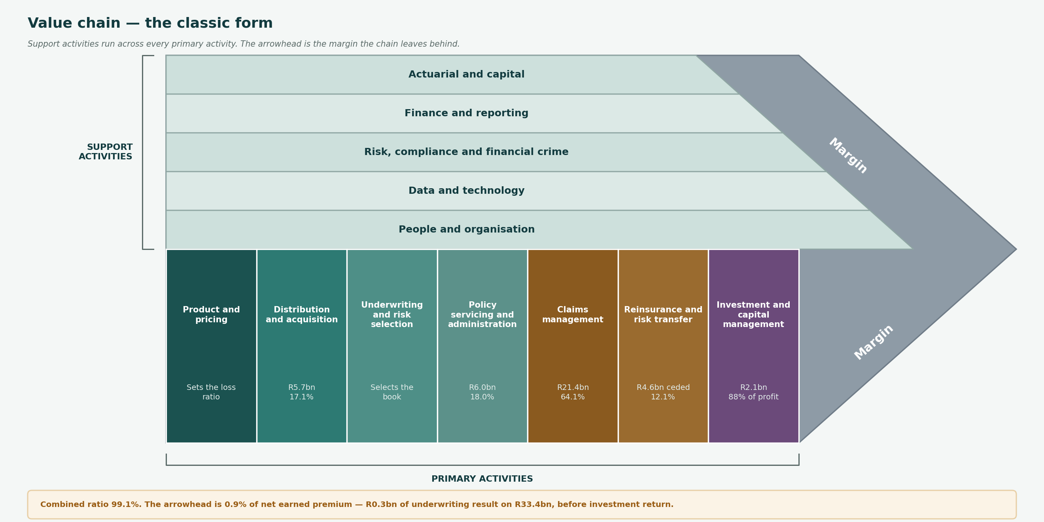
VALUE CHAIN
The classic form
Support activities span every primary activity. The arrowhead is the margin — 0.9% of net earned premium before investment return.

Slide 4
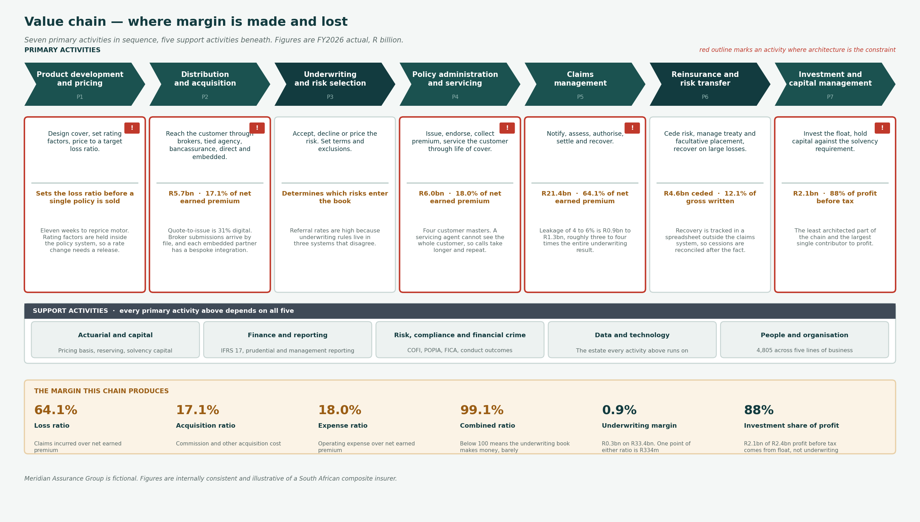
VALUE CHAIN
The same chain, with what each activity carries
The same seven activities, expanded. Red outline marks where architecture is the constraint on the margin rather than the market.

Slide 5
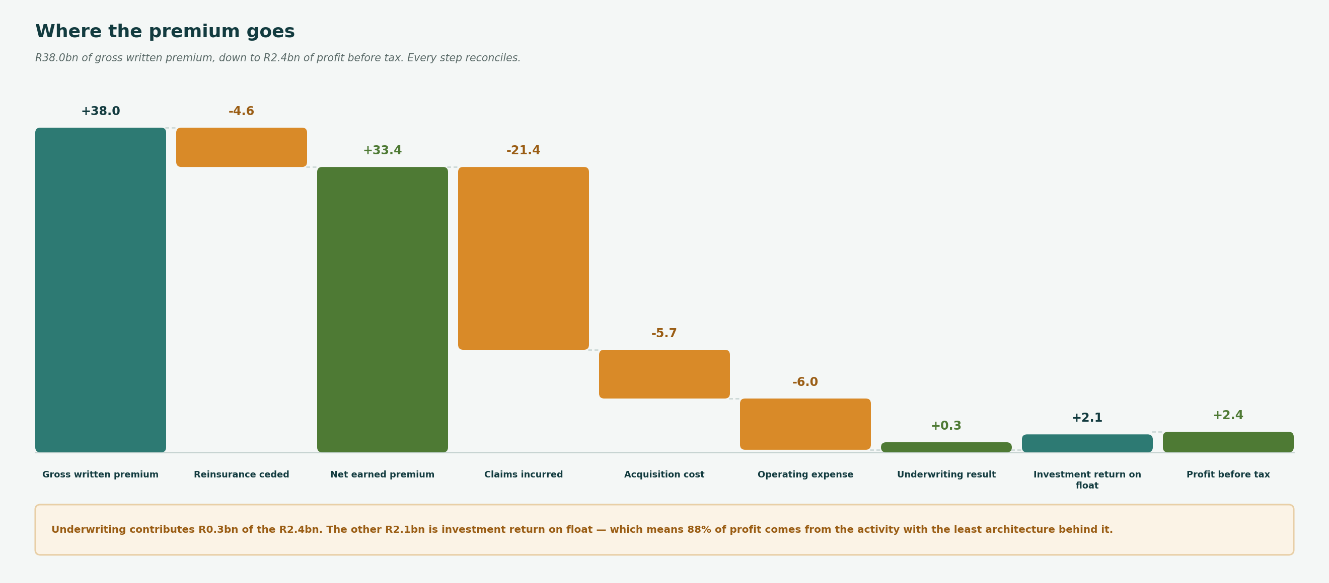
ECONOMICS
R38.0bn of premium down to R2.4bn of profit
Every step reconciles. Figures are FY2026 actual, group consolidated.

Slide 6
FINDINGS
What the chain says
The underwriting book barely makes money
Combined ratio 99.1%. R0.3bn of underwriting result on R33.4bn of net earned premium, a margin of 0.9%.
One point on either the loss ratio or the expense ratio is R334m, which is larger than the entire underwriting result. That is the sensitivity every architecture decision on this chain should be measured against.
Claims leakage dwarfs the margin it erodes
Leakage of 4 to 6% on R21.4bn of claims is R0.9bn to R1.3bn.
Roughly three to four times the underwriting result. No other single improvement on this chain is worth as much, and it is an assessment and authorisation problem before it is a technology one.
Most of the profit comes from the least architected activity
R2.1bn of R2.4bn profit before tax is investment return on float, not underwriting.
Investment and capital management has the thinnest architecture coverage of any primary activity. That is a coverage gap the capability has not addressed and should state plainly rather than leave implied.
Cost sits in servicing and acquisition, value sits in claims
Acquisition and operating expense together are R11.7bn, 35.0% of net earned premium.
Digitisation work concentrates here because the cost is visible. The larger prize is in claims, where the money is spent rather than the cost incurred.
Pricing agility is an architecture constraint, not a pricing one
Eleven weeks to reprice motor against a market that moves in days.
Rating factors are held inside the policy administration system. Until they are externalised, the pricing activity cannot respond at the speed the loss ratio requires.
One point of loss ratio or expense ratio is R334m. That is the number every architecture proposal on this chain should be measured against.

Slide 7
SO WHAT
Where the architecture work should go
Ranked by what the chain says is at stake, not by what is easiest to start.
1
Claims assessment and authorisation
R0.9bn – R1.3bn
Leakage is the largest single number on the chain and three to four times the underwriting result.
P5
2
Rating factor externalisation
R334m per point
Eleven weeks to reprice is an architecture constraint. One point of loss ratio pays for the work many times over.
P1
3
Single customer view
Servicing cost
Four masters make every servicing interaction longer. The benefit is real and harder to attribute than the two above.
P4
4
Broker straight-through processing
Acquisition cost
Reduces friction and cost to acquire. Adoption is not an architecture question and should not be claimed as one.
P2
5
Investment and capital management
R2.1bn of profit
No architecture coverage at all today. Not a proposal — a gap that should be stated before someone notices it.
P7
Item 5 is not work. It is a coverage gap on the activity that produces 88% of profit, and stating it is more useful than proposing something for it.

